Slide 1
Data Science CSCI 3320 Project: Oil-Spill Classification
Motasem Abunima, 120181826
Abdelrahman Dawoud, 120201585

Slide 2
About the domain

Slide 3
About the domain
The domain as the name suggests talks about detecting the oil-spill regions of the ocean, some of which contain an oil spill and some that do not.
Images taken through “Satellite Radar Images” were split into sections and processed using computer vision algorithms to provide a vector of features to describe the contents of the image section or patch.
There are 937 cases. Each case is comprised of 48 numerical computer vision derived features, a patch number, and a class label.

Slide 4
About the domain
There are two classes and the goal is to distinguish between spill and non-spill using the features for a given ocean patch.
Non-Spill: negative case, or majority class.
Oil Spill: positive case, or minority class.

Slide 5
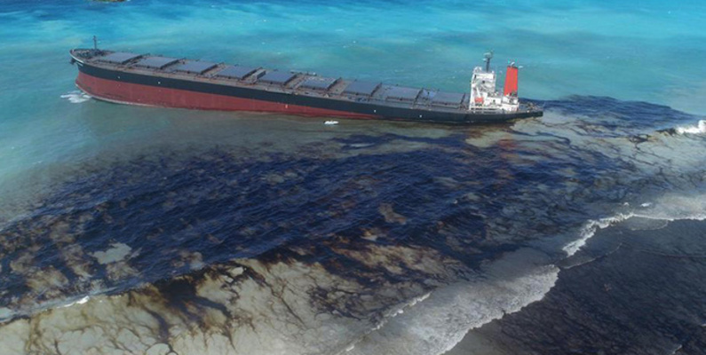
About the domain

Slide 6
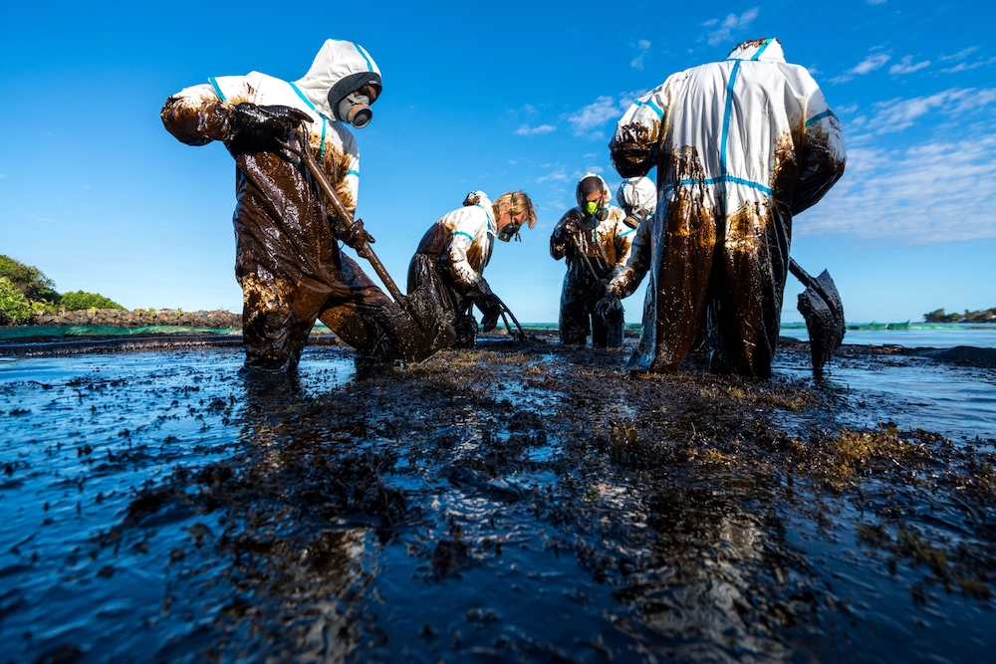
About the domain

Slide 7
About the data

Slide 8
About the data
The dataset was developed by starting with satellite images of the ocean, some of which contain an oil spill and some that do not.
Images were split into sections and processed using computer vision algorithms to provide a vector of features to describe the contents of the image section or patch.
The task is, given a vector that describes the contents of a patch of a satellite image, then predicts whether the patch contains an oil spill or not, e.g. from the illegal or accidental dumping of oil in the ocean.

Slide 9
About the data
There are two classes and the goal is to distinguish between spill and non-spill using the features for a given ocean patch.
Non-Spill: negative case, or majority class.
Oil Spill: positive case, or minority class.
The dataset link: https://www.kaggle.com/datasets/sudhanshu2198/oil-spill-detection

Slide 10
Data Exploration

Slide 11
Data exploration
There are 50 columns and 937 rows.
The data set has no missing values but has a lot of FALSY values, we will elaborate more later in the section.
The normal case is no oil spill assigned the class label of 0, whereas an oil spill is indicated by a class label of 1.
As we previously said, There are 896 cases of no oil spill and 41 cases of an oil spill.

Slide 12
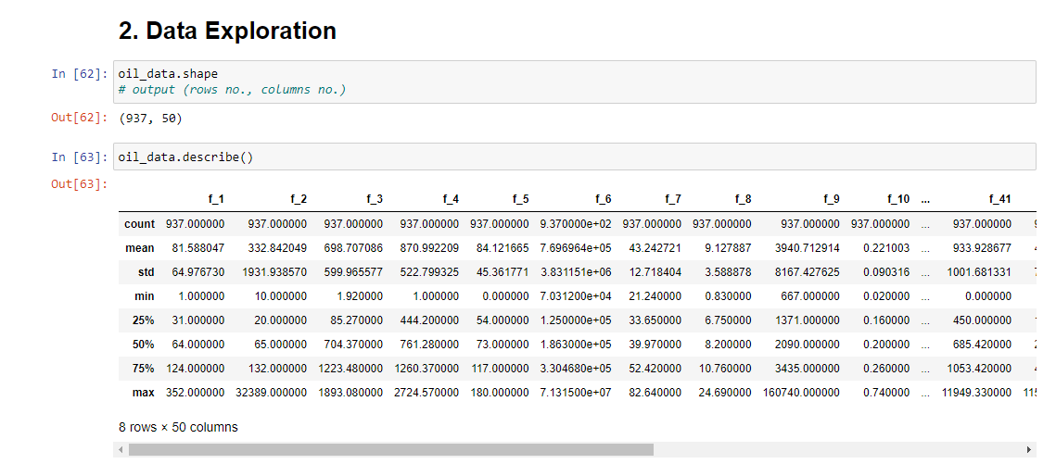
Data Exploration

Slide 13
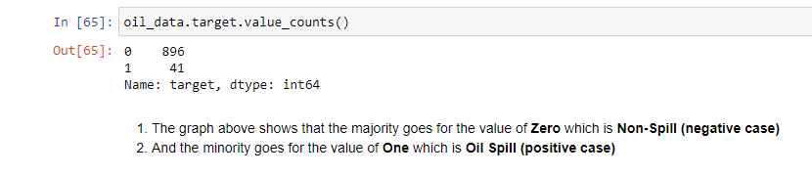
Data Exploration

Slide 14
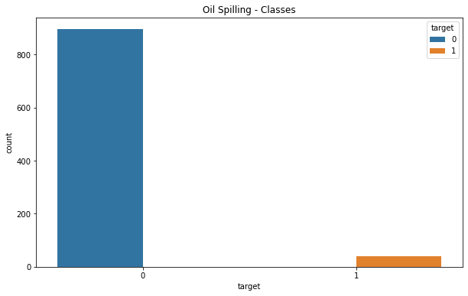
Data Visualization

Slide 15
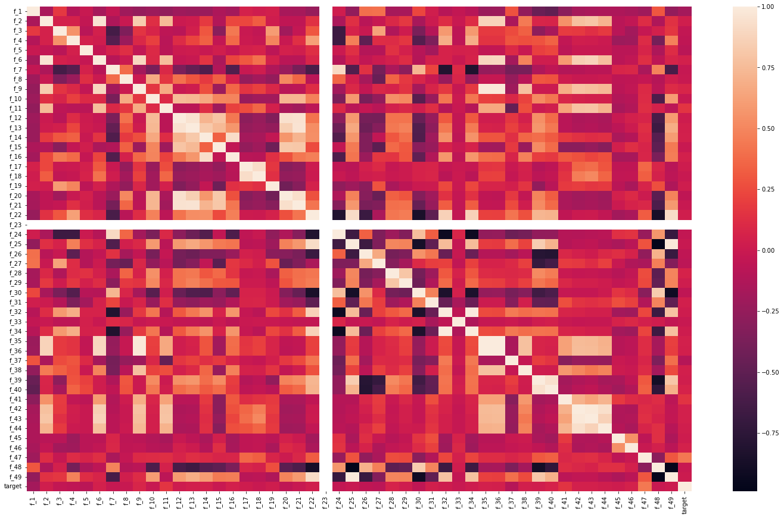
Data Visualization – Find Correlation

Slide 16
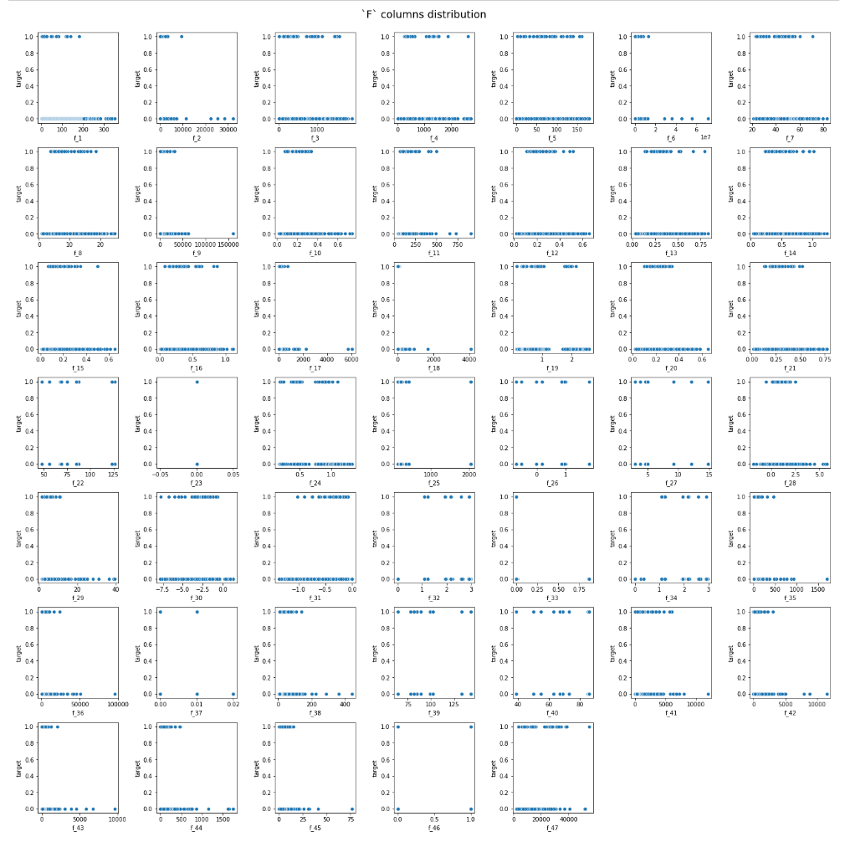
Data Visualization – Scatter Plot

Slide 17
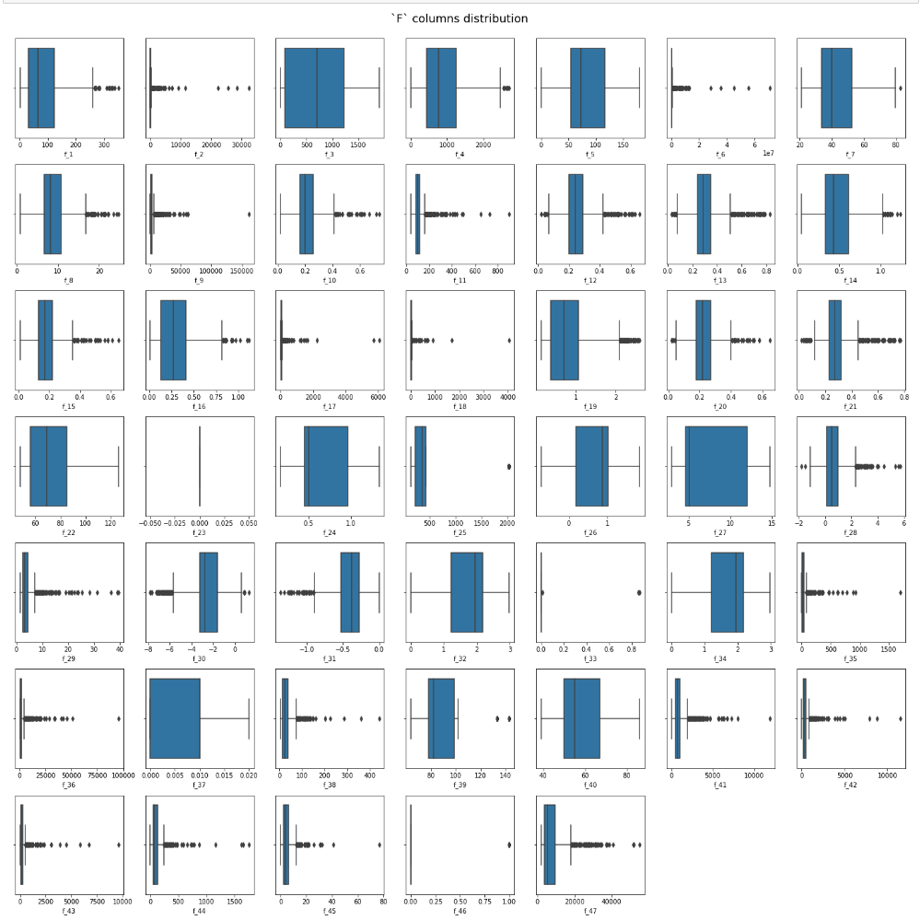
Data Visualization – Box Plot

Slide 18
Data Preparation

Slide 19
Data Preparation – Data Cleaning
We clean the data by doing some operations like:
Dropping the column f_23 since it does not affect the data as we saw previously in the heat map.
Data Augmentation to generate more data because our data set was imbalanced and the majority of our data is ZERO which represents the Non-Spill class.
Since we do not have any missing values in any column in our data set, we don’t have to clean the data from this perspective.

Slide 20
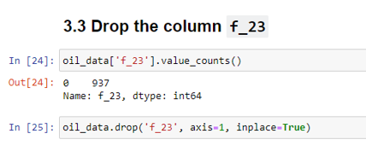
Data Cleaning

Slide 21
Data Preparation – Data Transformation
We apply data transformation by scaling all attributes to make all columns have the same range which is “between 0 and 1”.
As the scaled data frame in the next slide shows that the features `F` are scaled by `StandardScaler` which means scaling each feature to mean 0 and standard deviation 1.

Slide 22
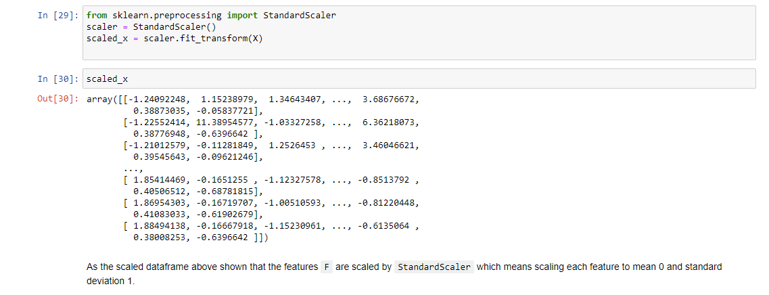
Data Transformation – Data Scaling

Slide 23
Data Preparation
Splitting the Data into Training and Testing parts.
Part | # of records | %
Training data | 702 | 75%
Testing data | 235 | 25%

Slide 24
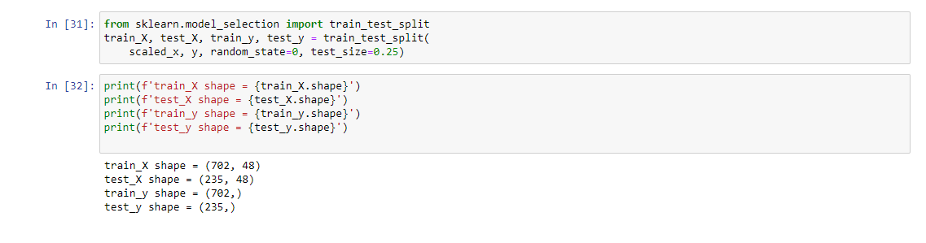
Splitting Data into (Training – Testing)

Slide 25
Predictive Analytics

Slide 26
Predictive Analytics
Fitting the model to the data:
We use RandomForest Algorithm to test the model.
We use Data Augmentation (Oversampling) to generate more data for the minority class because the data was imbalanced.
We split this phase into two sections:
Before oversampling minority class
After oversampling minority class

Slide 27
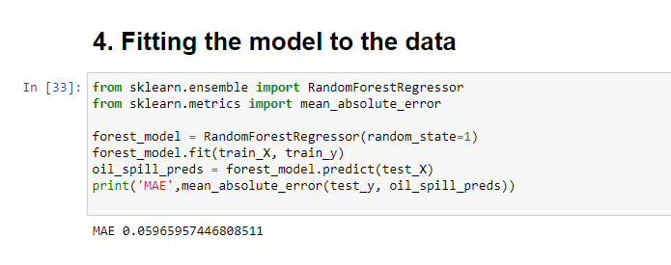
Fitting the model to the data – Before Oversampling

Slide 28
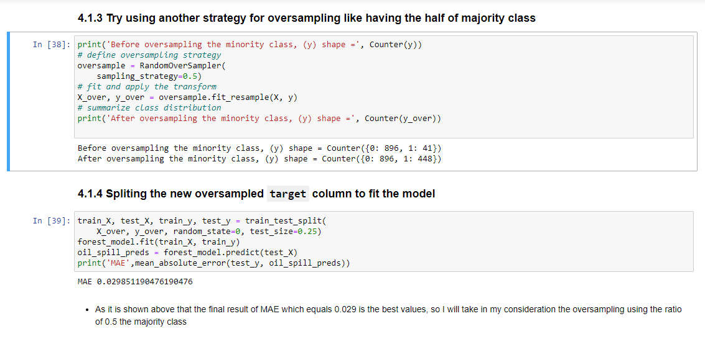
Fitting the model to the data – After Oversampling (half of majority class)

Slide 29
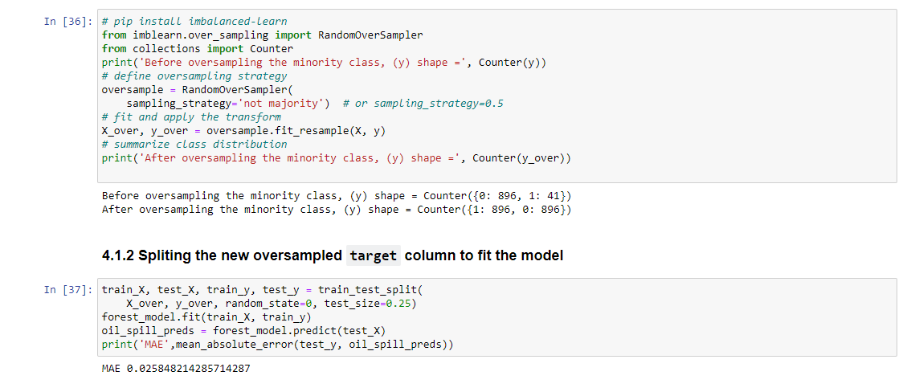
Fitting the model to the data – After Oversampling (equal to majority class)

Slide 30
Conclusions
After all, We have obtained a model that have the least MAE(Mean Absolute Error) of about 0.025 which is very good after using the oversampling the minority class to be equal to the majority class due to the imbalance of our data.

Slide 31
References
GitHub Repository: https://github.com/MotasemZiad/Oil-Spill-Classification
https://scikit-learn.org/stable/modules/generated/sklearn.ensemble.RandomForestRegressor.html
https://imbalanced-learn.org/stable/references/generated/imblearn.over_sampling.RandomOverSampler.html
https://scikit-learn.org/stable/modules/generated/sklearn.preprocessing.StandardScaler.html

Slide 32
☺

